Slide 1


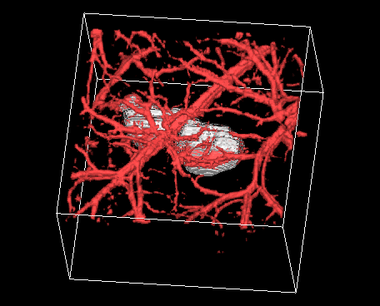
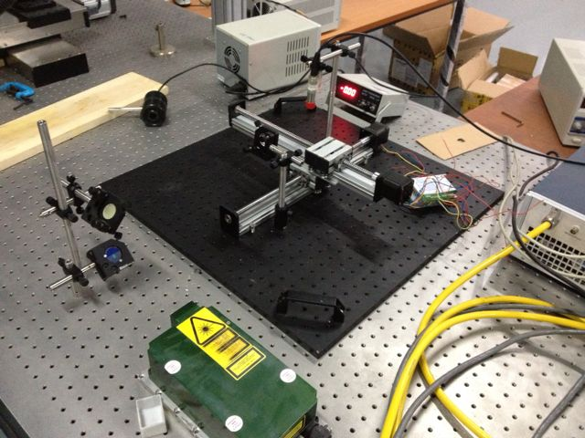
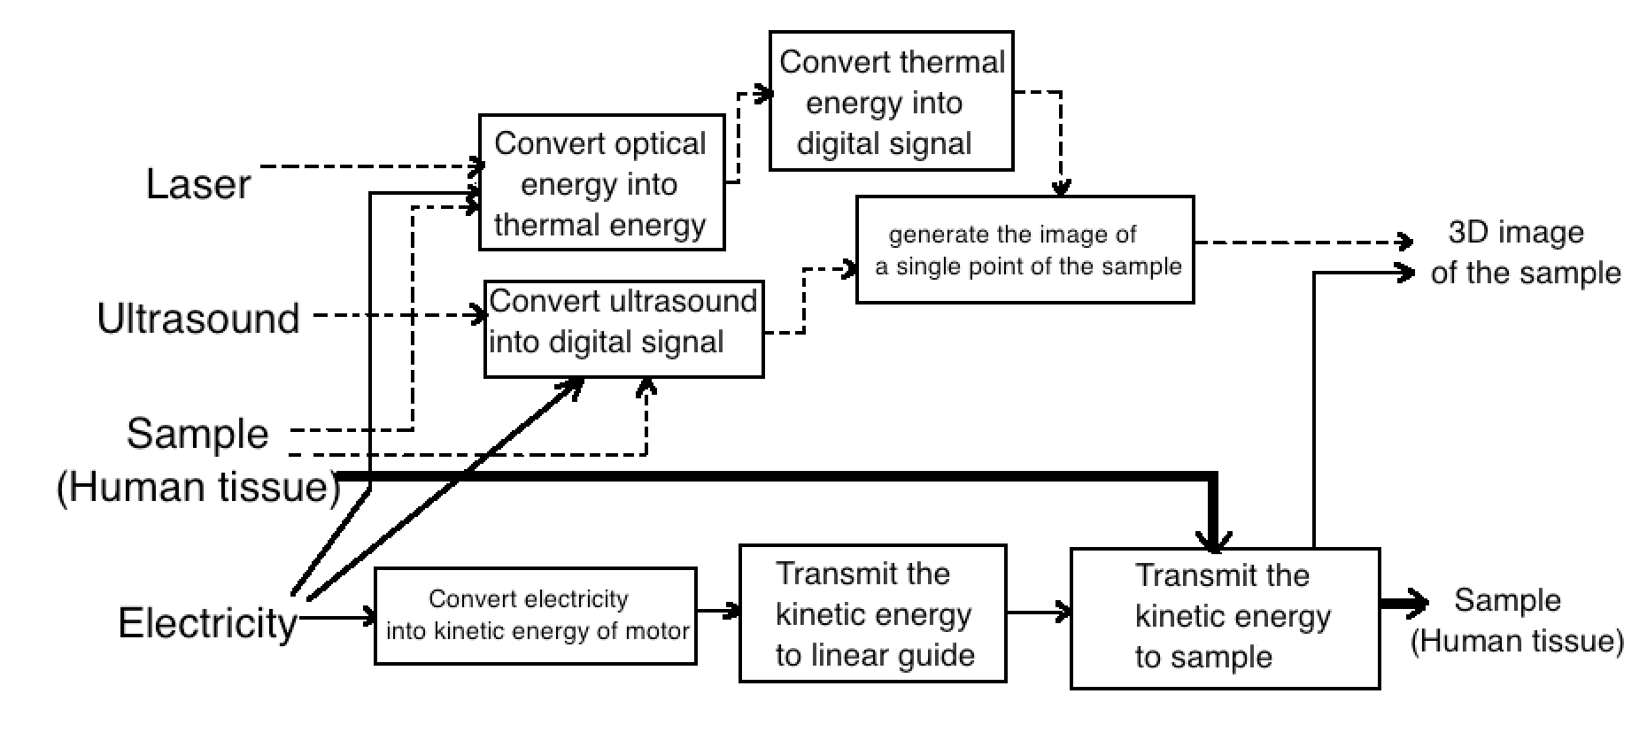
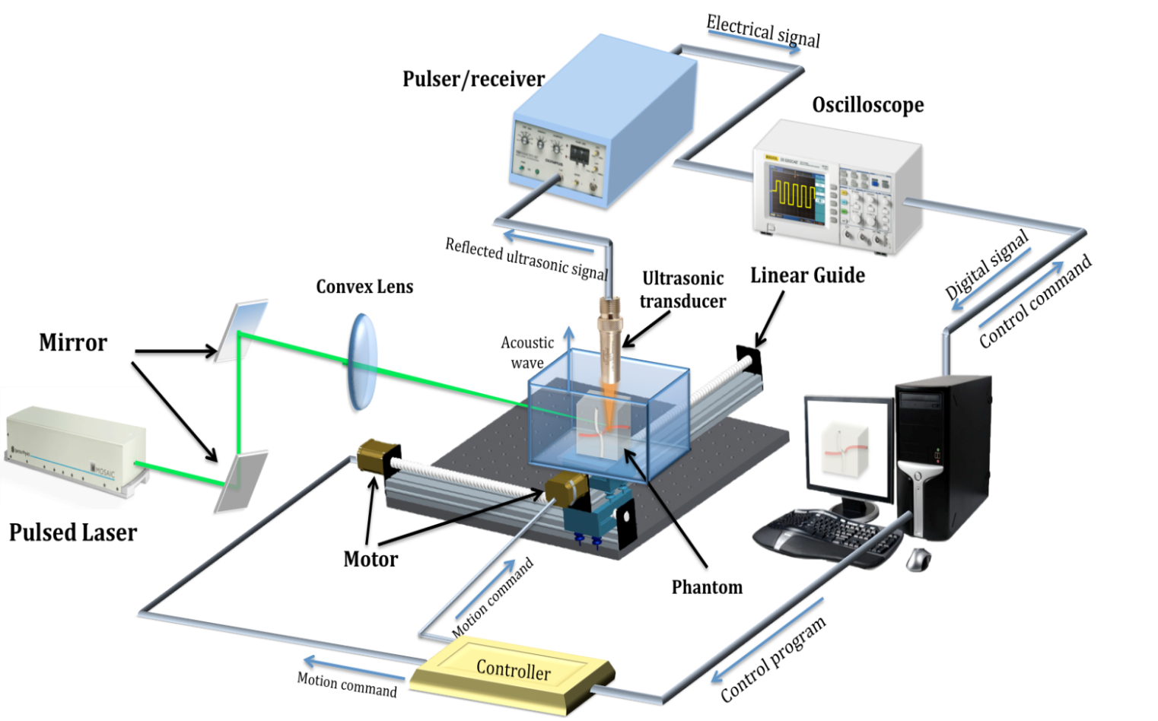
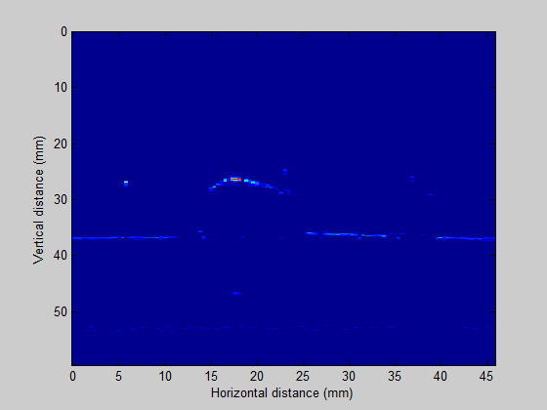
VM450 • Design and Manufacturing III
& VE450 • Major Design Experience
Photoacoustic Ultrasound (PAUS) for Co‐Registered Imaging of Bone Structure and Vasculature
Sponsor: Shawn Ma, Covidien
Team Members: Song Guo, Yao Hou, Chen Li, Tianxiang Xu, Yuhan Zhang
Faculty Advisor: Prof. Sung-Liang Chen Instructor: Prof. Shane Johnson
Problem Statement
Some diseases, such as cancer, cannot be easily detected in early stage. Both the two existing imaging techniques, photoacoustic and ultrasound imaging are not able to detect the osseous and vascular structure simultaneously. This project is to combine these two techniques to build the dual modality system and reconstruct the 3D image of human tissue.
Fig. 1 3D image of human bone and vasculature [1]
Concept Generation
Sub-system concepts are converting the thermal energy caused by laser and energy of ultrasonic wave into digital signals. And a phantom should be designed to simulate the human tissue, since phantom can be easily used for validation.
Fig. 2 Detailed structure function
Fig. 3 Concept Diagram
Design Description
The design uses two step motors to move the phantom in XY plane. Three mirrors lead the green laser to shoot from the side of phantom to heat up the blood. The transducer receives the thermal signal reflected from vessels and also sends and receives
the ultrasound signal reflected from the bone. The two signals of laser and ultrasound can alternately appear on the oscilloscope. Using labview, the signal can be transformed into data in Matlab. By dealing with the data of depth, the 3D image can be shown on the laptop screen.
Fig.4 The whole set-up system
Modeling and Analysis
A matlab model is built to transform the depth data into 3D image. It firstly transforms the raw data into 2D image. The following graph shows a 2D bone profile of the phantom. Same modeling method can be used to transform 2D image to 3D.
Fig. 5 2D bone profile
Validation
Validation Process:
For step length, a ruler was set along the track and then the running time was set for 100. Then the system ran. When it stops, the distance between starting and end can be measured.
For loading bearing, a 10kg object was put on the track and then system can be started. If the track can run normally and no deflections happen, it can meet this specification.
For data processing speed, a timer can be used to measure.
Some other specifications can also be verified using easy experiments.
Validation Results:
According to validation part, most specifications can be met.
Transducer frequency>=10MHz
Wavelength of laser>=523nm
Motor speed>=1200mm/s
Step length<=50um/step
Load bearing>=10kg
Weight<=100kg
Cost<=500000RMB
Time for data processing<= 30min
√ means having been verified and · means to be determined.
Conclusion
Photoacoustic and ultrasound imaging techniques can be used for detecting osseous and vascular structures simultaneously. The key to achieve this goal is to set up the dual modality system. And also, the accuracy and speed of the detection is very important to form the images.
Acknowledgement
Sponsor: Shawn Ma from Covidien
Shane Johnson, Sung-Liang Chen and Huan Qi from UM-SJTU Joint Institute
Hongkun Lai and Xunjie Cai from UM-SJTU Joint Institute
Reference
[1]http://labs.seas.wustl.edu/bme/Wang/index.html
University of Michigan - Shanghai Jiao Tong University Joint Institute
Notes:
<number>

